Slide 1
Robotic Process Automation
in ERP SAP ByDesign Systems
Team Members -
Ankita Lodhavia
Anushka Pandhare
Ajinkya Ambike
Namrata Patil
Shubhankar Nanda
Viraj Shah
Neetesh Hegde

Slide 2

CONTENT
Our Initial Problem Statement
Different AI options
Why RPA?
Use Cases
Project 1: Invoice Details Extraction
Project 2: Contract Creation in SAP ByDesign
Summary

Slide 3

Week 1
What can ERP Logic do in AI & ML space to help clients be more successful?
Our Initial Problem Statement
How will AI & ML add value to ERP Logic’s clients?
Learn new skills while building the strategy to build AI & ML solution

Slide 4
Different AI Options We Explored
Week 2
Robotic Process Automation
Develop capabilities to handle repetitive and regular activities like Record Maintenance, transactions, queries, etc.
Chatbots
Offer 24/7 availability to the customer
Exponentially reduce cost of investment to service provider
For customer interactions, to better service them
Blockchain
Record transactions in an unalterable ledger distributed across blockchain network
Helps to automate settlements & reduce time to payment
Can be used to mitigate fraud
Internet of Things
Collect, analyze & process data from sensors in the Supply Chain
ERP system will organize the unstructured data coming from different sensors into structured format to make business sense

Slide 5
Why Robotic Process Automation?
Week 3
Accuracy
Improved Employee Morale
Low Technical Barrier
Productivity
Compliance
Reliability
Non-Invasive Technology
Consistency

Slide 6
Robotic Process Automation Spectrum
When to use RPA?
Week 4
High volume, highly repetitive processes
High value processes
High stakes processes
Take significant time that could be spent on work that requires more human thinking
“money” processes like sales quotes or those that create a better customer experience and reduce churn
Copy-and-paste error results in costly compliance violation or process backlog causes routine missing of deadlines

Slide 7
Use Cases for RPA in an ERP System
Week 4
Challenges
RPA Solution
Compilation of Audit & AP Data
RPA will automate compilation of data and identify any mismatches
Data Readiness
RPA can be used to reduce manual work of gathering, data entry and validation
Transport Management System
Collation, consolidation & distribution of documents
Automating back-end document management system & integrating different documents will also result in faster shipment releases
Purchase Order Follow-Up
RPA can access various SAP reports and transactions to provide a summary of purchase orders where follow-up outside of the SAP system is required

Slide 8
Robotic Process Automation Spectrum
Project 1: Invoice Details Extraction
Week 5-7
Run bot to read PDF Invoices and Extract Data to Excel
Download Invoice in a Folder
End
Load Data into Excel Sheet, Save and Close the File
Open Empty Excel Sheet
Start

Slide 9
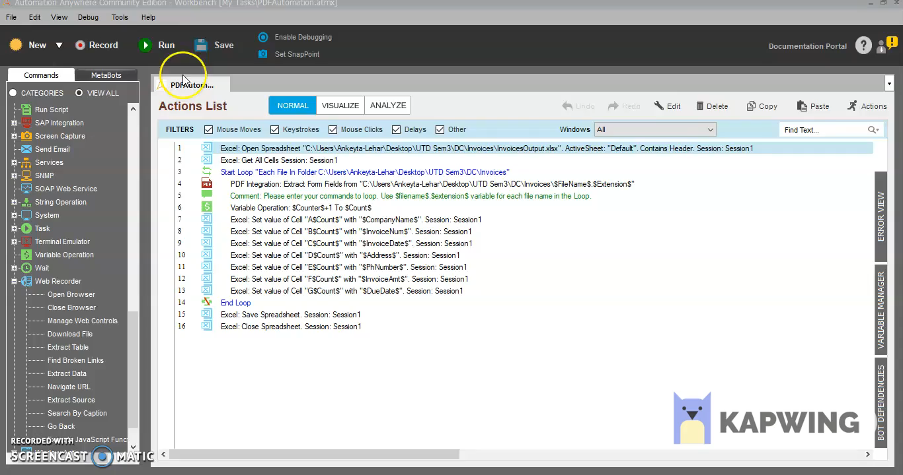
Robotic Process Automation Spectrum
Project 1: Invoice Details Extraction
Week 5-7

Slide 10

Robotic Process Automation Spectrum
Project 2: Sales Order Contract Creation in SAP ByDesign
Week 8-12
Downloads the new contract template onto the local machine
Bot prompts user for AccountID
Product Master Sheet with data for each AccountID
?
End
Bot connects to the Product Master Sheet by treating it as a Database
Bot logs into SAP ByDesign system
Fetch data from Master Sheet and load into contract
Start

Slide 11
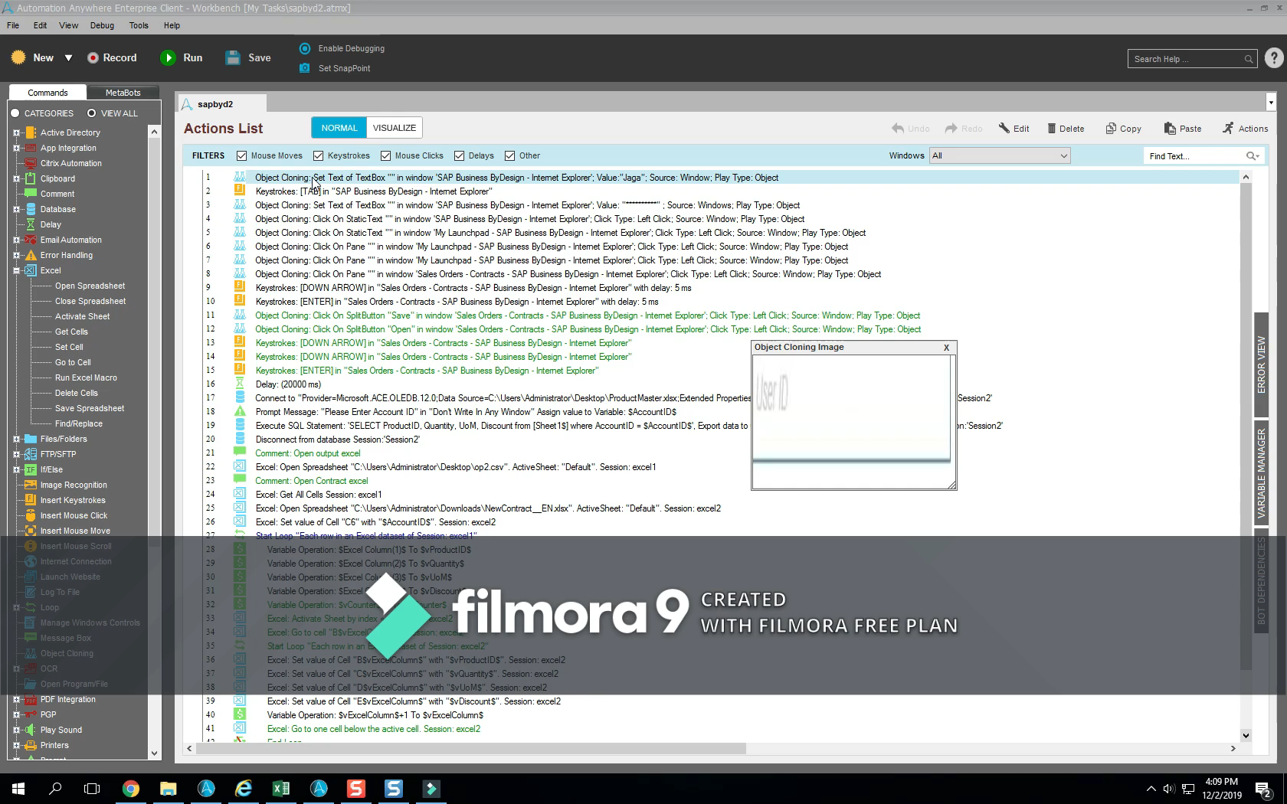
Robotic Process Automation Spectrum
Project 2: Sales Order Contract Creation in SAP ByDesign
Week 8-12

Slide 12
Robotic Process Automation Spectrum
Summary
01
AI improves ERP systems by increasing operational efficiency
02
Robotic Process Automation helps reduce repetitive manual tasks and improves efficiency and reduces human-error
03
RPA can be used in different branches of an ERP system to free up important time for tasks requiring a human touch
04
Using an RPA bot will drastically reduce the time taken to extract invoice details from a Purchase Order with high accuracy
05
Our RPA bot is reducing the manual tasks of creating a Sales Order contract in the SAP ByDesign system being built by ERP Logic
06
In conclusion, it is important to invest in RPA and AI as a whole for improving the efficiency of ERP solutions

Slide 13
Robotic Process Automation Spectrum
Questi ns

Slide 14
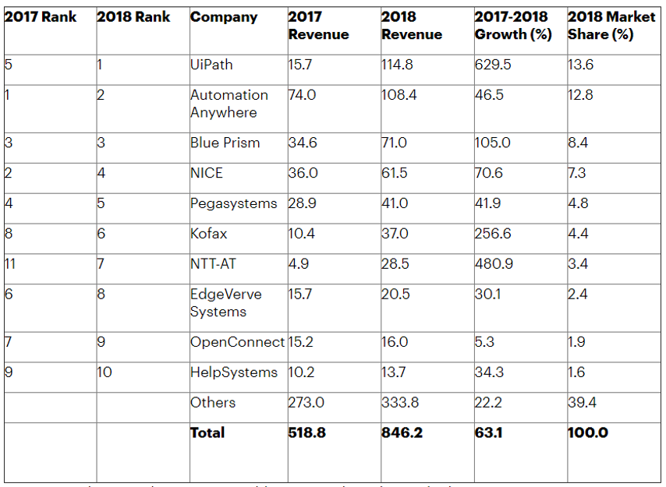
Robotic Process Automation Spectrum
APPENDIX 1
RPA Revenue growths and Market Leaders
Robotic process automation (RPA) software revenue grew 63.1% in 2018 to $846 million, making it the fastest-growing segment of the global enterprise software market, according to Gartner, Inc. Gartner expects RPA software revenue to reach $1.3 billion in 2019.
Top companies implementing RPA:
UiPath: Offers various solutions for various industries like BPO, Healthcare, Insurance, Finance, Manufacturing, Business Process Automation and many more. The various Business Processes it can help with include Accounts, Claims processing, HR and Legal automation to name a few.
BluePrism: One of the top RPA companies, which initially invented the term Robotic Process Automation. It uses .NET framework to build the platform and offers features like scalability, compliance, security.
Automation Anywhere: Products combine traditional RPA with cognitive elements such as natural language processing and reading unstructured data. These include bots with machine-learning capabilities.

Slide 15
Robotic Process Automation Spectrum
APPENDIX 2
Few Other Use Cases
1. Financial Services and Banking: Automate data validations, data migration between banking applications, customer account management, report creation, comparing mortgage values between cities, form filling, financial claims processing, updating loan data and backing up teller receipts.
2. Technology / Software: Automate Hardware and software testing for functional, load, and mobile performance.
3. Telecommunications: Collecting and consolidating data from client phone systems, backing up information from client systems, uploading data, extracting data about competitor pricing, phone manufacturing information, etc.
4. Manufacturing: Automate ERP, logistics data, data monitoring, pricing comparisons.
5. Hospitality: Automate competitor pricing analysis, guest data processing, data verification, payment processing, user account creation.
6. Retail: Automate extracting product data from manufacturers’ websites, updating online inventory and product information, importing website and email sales.
7. Procure-to-pay: Automate the transactional work involved with obtaining and routing items and ensure data flows seamlessly between systems.
8. Quote-to-cash: Expedite sales processes, automate pricing, quoting, order management, invoicing, and payment completion.
9. HRM Automation: Automate payroll, benefits administration, compliance reporting, and more.
10. Consumer Goods: Automate order processing, data entry, resolution consulting, claims processing, FTP automation, incentive claims processing

